Slide 1
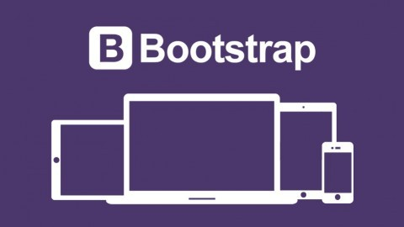

Slide 2
What is Responsive Web Design?
Responsive web design is about creating web sites which automatically adjust themselves to look good on all devices, from small phones to large desktops.
Bootstrap is the most popular HTML, CSS, and JavaScript framework for developing responsive, mobile-first web sites.
Bootstrap is completely free to download and use!
Advantages of Bootstrap:
Easy to use: Anybody with just basic knowledge of HTML and CSS can start using Bootstrap
Responsive features: Bootstrap's responsive CSS adjusts to phones, tablets, and desktops
Mobile-first approach: In Bootstrap 3, mobile-first styles are part of the core framework
Browser compatibility: Bootstrap is compatible with all modern browsers (Chrome, Firefox, Internet Explorer, Safari, and Opera)

Slide 3
What is Bootstrap?
Bootstrap is a free front-end framework for faster and easier web development
Bootstrap includes HTML and CSS based design templates for typography, forms, buttons, tables, navigation, modals, image carousels and many other, as well as optional JavaScript plugins
Bootstrap also gives you the ability to easily create responsive designs
Bootstrap is famous for being developed with components that have the ability to follow the property of responsive designs
Responsive Design is about using CSS and HTML to resize, hide, shrink, enlarge, or move the content to make it look good on any screen
Responsive Design allow your page works for computer, tablets and mobile phones.

Slide 4
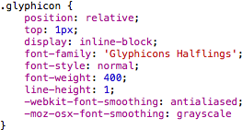
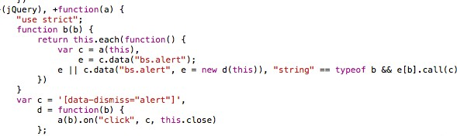
What is Bootstrap?
In other words, bootstrap is a collection of CSS classes and JavaScript functions the you get ready to use and will not worry about write code like this:

Slide 5
First Bootstrap Page
You will need to include three files:
bootstrap.min.css
jquery.min.js
bootstrap.min.js
You must download it and include in you page
For this example, we include from the Internet

Slide 6
Where to Get Bootstrap?
There are two ways to start using Bootstrap on your own web site.
Download Bootstrap from getbootstrap.com
If you want to download and host Bootstrap yourself, go to getbootstrap.com, and follow the instructions there.
Include Bootstrap from a CDN
If you don't want to download and host Bootstrap yourself, you can include it from a CDN (Content Delivery Network).
MaxCDN provides CDN support for Bootstrap's CSS and JavaScript. You must also include jQuery.

Slide 7
Bootstrap CDN
You must include the following Bootstrap’s CSS, JavaScript, and jQuery from MaxCDN into your web page.
<!-- Latest compiled and minified Bootstrap CSS --> <link rel="stylesheet"href="https://maxcdn.bootstrapcdn.com/bootstrap/3.3.7/css/bootstrap.min.css">
<!-- Latest compiled Bootstrap JavaScript --> <script src="https://maxcdn.bootstrapcdn.com/bootstrap/3.3.7/js/bootstrap.min.js"></script>
<!-- latest jQuery library --> <script src="https://code.jquery.com/jquery-latest.js"></script>

Slide 8
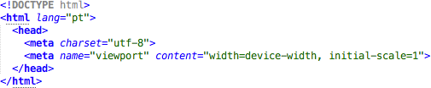
First Bootstrap Page
Include the HTML5 doctype at the beginning of the page, along with the lang attribute and the correct character set

Slide 9
First Bootstrap Page
Meta viewport tag ensure proper rendering and touch zooming
Width of the page to follow the screen-width of the device and initial zoom level to default zoom level of device
User will have a better experience, thus will not need zoom the page to view page information

Slide 10
Create Web Page with Bootstrap
Bootstrap is mobile-first
Bootstrap 3 is designed to be responsive to mobile devices. Mobile-first styles are part of the core framework.
To ensure proper rendering and touch zooming, add the following <meta> tag inside the <head> element:
<meta name="viewport" content="width=device-width, initial-scale=1">
The width=device-width part sets the width of the page to follow the screen-width of the device (which will vary depending on the device).
The initial-scale=1 part sets the initial zoom level when the page is first loaded by the browser.

Slide 11
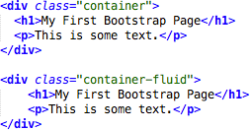
First Bootstrap Page
Bootstrap has a concept of containing element to wrap site contents

Slide 12
Containers
Containers
Bootstrap also requires a containing element to wrap site contents.
There are two container classes to choose from:
The .container class provides a responsive fixed width container.
The .container-fluid class provides a full width container, spanning the entire width of the viewport.
Note: Containers are not nestable (you cannot put a container inside another container).

Slide 13
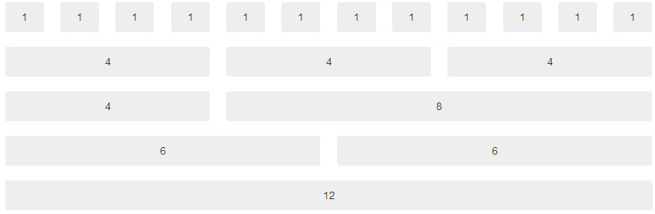
Bootstrap Grids
Bootstrap's grid system allows up to 12 columns across the page
You can divide the container in rows and each row in columns with space multiple of the 12

Slide 14
The Bootstrap grid system has four classes:
xs (for phones)
sm (for tablets)
md (for desktops)
lg (for larger desktops)
The classes above can be combined to create more dynamic and flexible layouts.

Slide 15
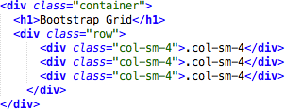
Bootstrap Grids
In the bellow example, we divide the space inside the container in 1 row and this row in 3 columns with the same side. 4+4+4 = 12
You can use any combination that the sum be equal to 12.

Slide 16
Bootstrap Grids
Bootstrap’s grid system allows up to 12 columns across the page.
If you do not want to use all 12 columns individually, you can group the columns together to create wider columns:
<div class="col-md-12">Span 12 columns</div>
<div class="col-md-6">Span 6</div><div class="col-md-6">Span 6</div>
<div class="col-md-4">Span 4</div><div class="col-md-8">Span 8</div>
<div class="col-md-4">Span 4</div><div class="col-md-4">Span 4</div>
<div class="col-md-4">Span 4</div>
Bootstrap's grid system is responsive, and the columns will re-arrange automatically depending on the screen size.

Slide 17
<div class="row"> <div class="col-*-*"></div> </div> <div class="row"> <div class="col-*-*"></div> <div class="col-*-*"></div> <div class="col-*-*"></div> </div> <div class="row"> ... </div>
First; create a row (<div class="row">). Then, add the desired number of columns (tags with appropriate .col-*-*classes). Note that numbers in .col-*-* should always add up to 12 for each row.

Slide 18
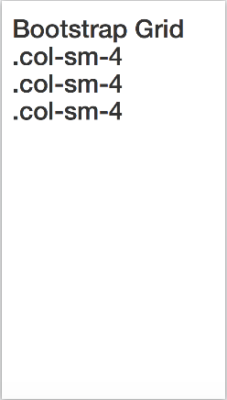
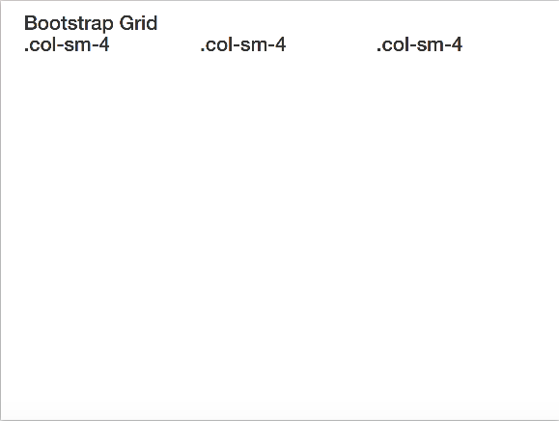
Bootstrap Grids
Responsive Bootstrap's grid system with 3 columns
small screens
big screens

Slide 19
Bootstrap Table
4 main classes:
.table
.table-striped
.table-bordered
.table-hover
5 contextual classes:
.active
.success
.info
.warning
.danger

Slide 20
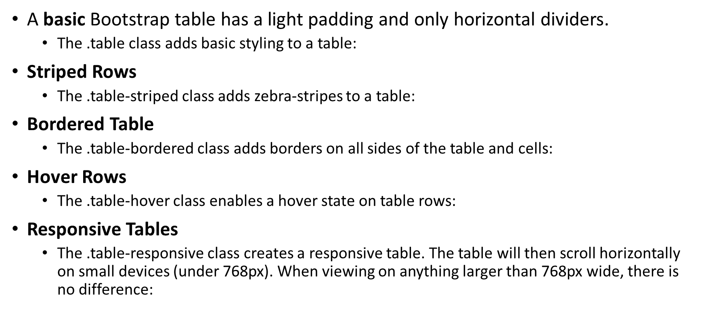
Bootstrap Table

Slide 21
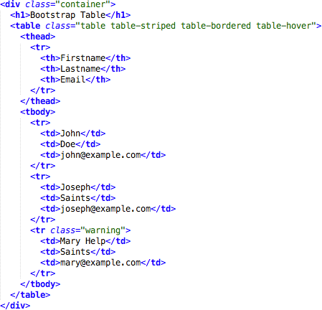
Bootstrap Tables

Slide 22
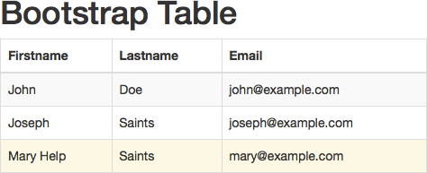
Bootstrap Tables

Slide 23
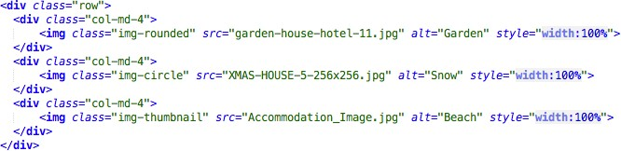
Bootstrap Images
3 main classes:
. img-rounded
. img-circle
. img-thumbnail

Slide 24
Bootstrap Images
Rounded Corners
The .img-rounded class adds rounded corners to an image (IE8 does not support rounded corners):
Circle
The .img-circle class shapes the image to a circle (IE8 does not support rounded corners):
Thumbnail
The .img-thumbnail class shapes the image to a thumbnail:
Responsive Images
Images comes in all sizes. So do screens. Responsive images automatically adjust to fit the size of the screen.
Create responsive images by adding an .img-responsive class to the <img> tag. The image will then scale nicely to the parent element.
The .img-responsive class applies display: block; and max-width: 100%; and height: auto; to the image:

Slide 25
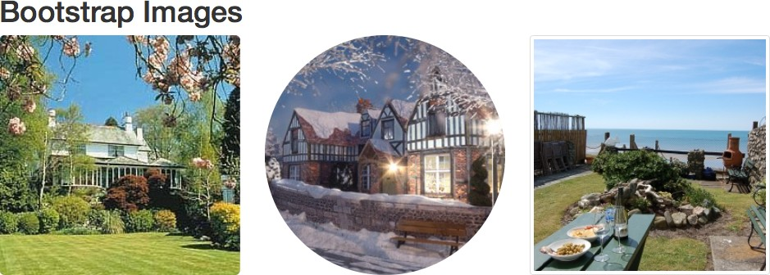
Bootstrap Images

Slide 26
Bootstrap Alerts
Bootstrap provides an easy way to create predefined alert messages
Alerts are created with the .alert class, followed by one of the four contextual classes
.alert-success
.alert-info
.alert-warning
.alert-danger

Slide 27
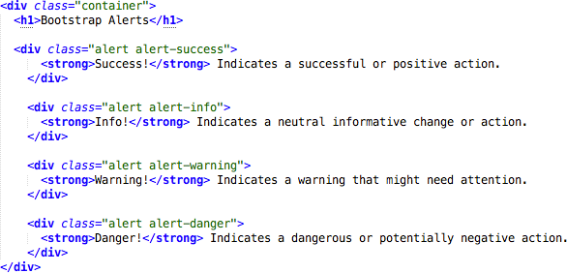
Bootstrap Alerts

Slide 28
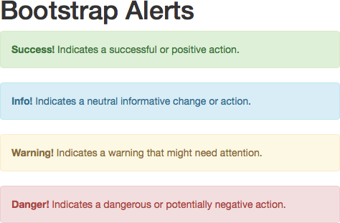

Slide 29
Bootstrap Buttons
Button Styles
Bootstrap provides seven styles of buttons with the following classes:
.btn-default
.btn-primary
.btn-success
.btn-info
.btn-warning
.btn-danger
.btn-link
The button classes can be used on the following elements:
<a>
<button>
<input>

Slide 30
Button Sizes
Bootstrap provides four button sizes with the following classes:
.btn-lg
.btn-md
.btn-sm
.btn-xs
Active/Disabled Button:
A button can be set to an active (appear pressed) or a disabled (unclickable) state:
The class .active makes a button appear pressed, and the class .disabled makes a button unclickable
Block Level Buttons
A block level button spans the entire width of the parent element.
Add class .btn-block to create a block level button

Slide 31
Bootstrap Buttons
Bootstrap provides seven styles of buttons:
To achieve the button styles above, Bootstrap has the following contextual classes:
.btn-default
.btn-primary
.btn-success
.btn-info
.btn-warning
.btn-danger
.btn-link

Slide 32
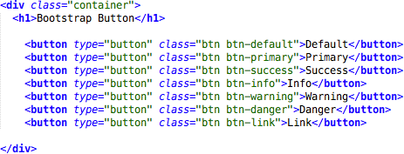
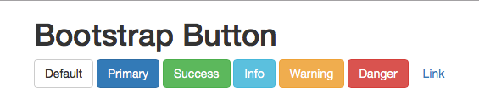
Bootstrap Buttons

Slide 33
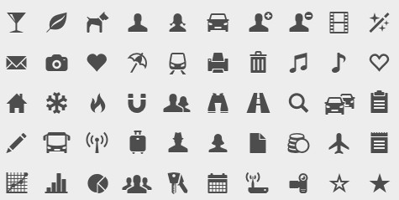
Bootstrap Glyphicons
Bootstrap provides 260 glyphicons from the Glyphicons Halflings set
(http://getbootstrap.com/components/)

Slide 34
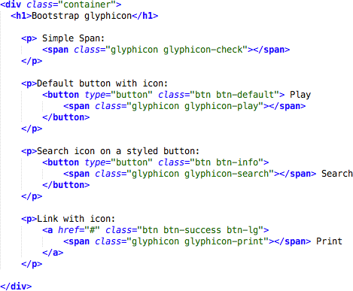
Bootstrap Glyphicons

Slide 35
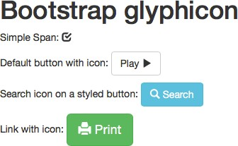

Slide 36
Bootstrap Labels
Labels are used to provide information about something
Bootstrap create labels with colorful backgrounds to highlight the text inside de label
Use the .label class, followed by one of the six contextual classes .label-default, .label-
primary, .label-success, .label-info, .label-warning or .label-danger

Slide 37

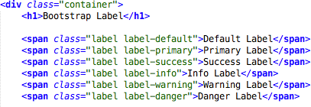

Slide 38
Bootstrap Panels
A panel in bootstrap is a bordered box with some padding around its content that can be use to highlight or separated some information
Like other bootstrap elements panel has contextual classes also (.panel-default, .panel-primary, .panel- success, .panel-info, .panel-warning, or .panel- danger)

Slide 39
